Slide 1





Standardization for Interoperability as a National Defense
Michael Mwangi
Yusuf Ajack
Nelson Akenga
Advancing Health Security through Science, Innovation and Equity / Pandemic preparedness and response.
Kenya Health Security Convention | 5th – 8th May 2026 | Mombasa - Kenya

Slide 2
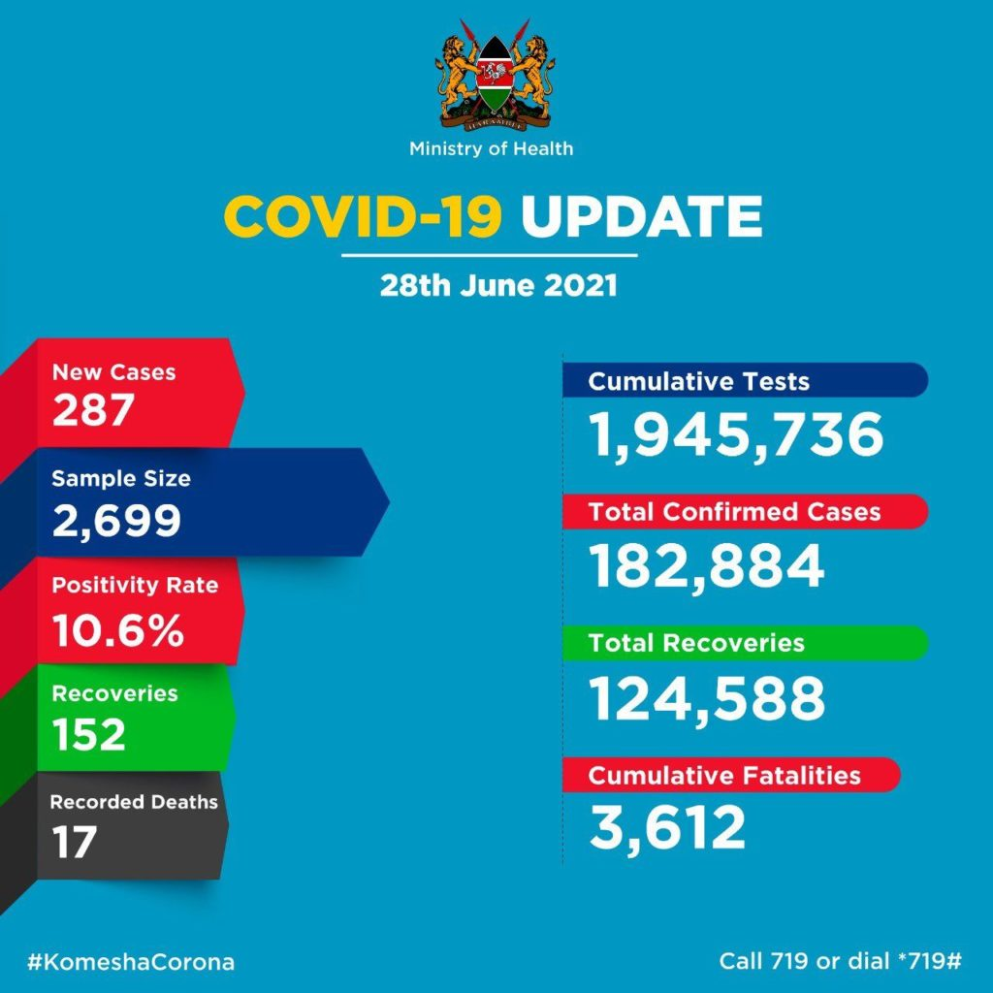
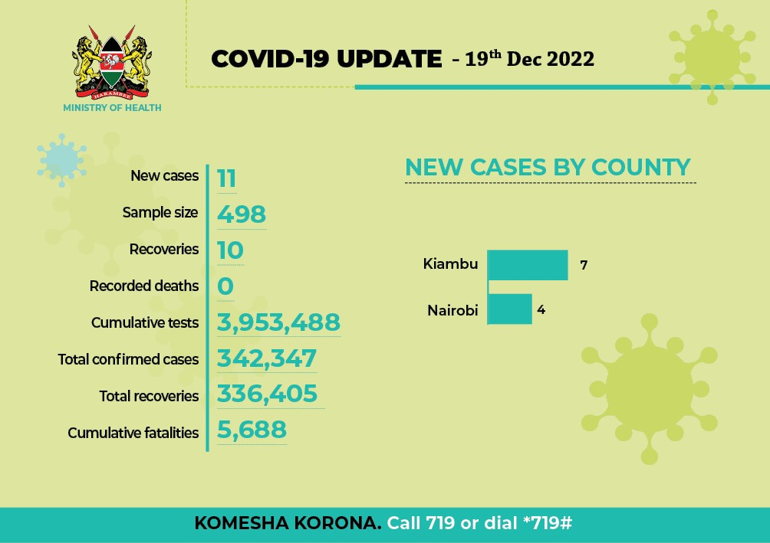
Background
  The Covid 19 pandemic exposed the value of granular data vs the traditional Weekly and monthly aggregates
  Kenya Diagnostics dashboard was a combination of public and private hospitals Laboratory information systems data , and excel templates

Slide 3
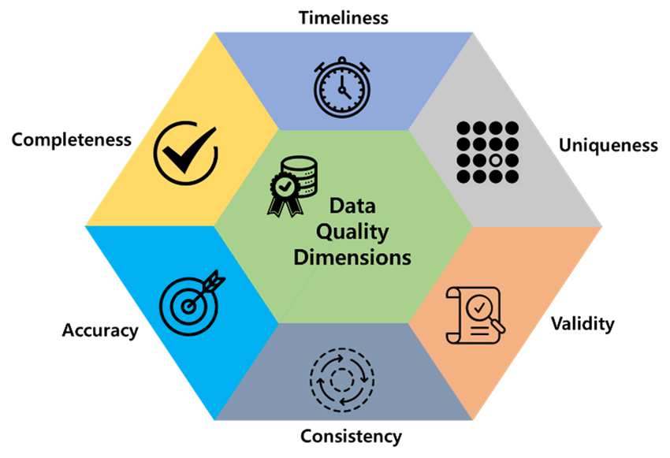
Objectives
  Quantify the Data quality impact of interoperability for integrated systems : LIMS , Self Registration & ADAM
  assessment for implementation of interoperability (compliance and integration)

Slide 4
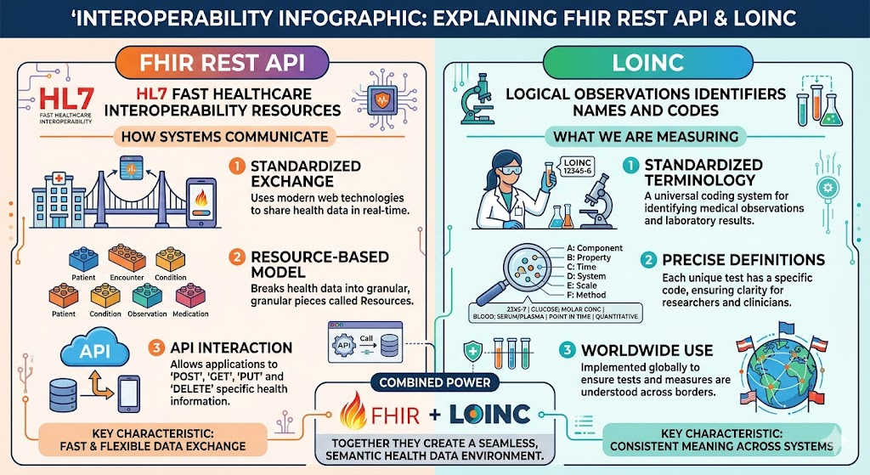
Methodology
 | Challenge | Solution | Standard
What : | Test Orders and results | Standardized orders and results | LOINC
How : | Data exchange method | Standardized data exchange REST API | FHIR
Ai generated Image for illustration

Slide 5
Methodology
  Secondary Analysis - utilizing existing data sources i.e. paper forms and digital records in LIMS
  A stratified random sample of 48 forms (4 per month from 2025) was audited to determine the accuracy of transcribed data.
  Data Analyzed using Excel with statistical plugins
  Cross-Validation - Triangulating findings between original paper records and subsequent digital system entries using local LLM (Anything LLM with native Models)
  Client ID – being a PII was salted for anonymity
  Implementation times derived from planning minutes with ICAP and Training Schedules

Slide 6
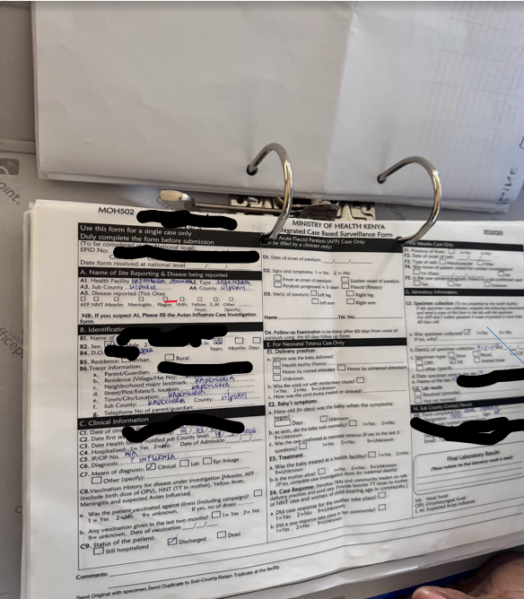




Methodology
  Integrated case reporting tool
Anything LLM
built-in OCR & RAG engine
Completeness
Accuracy vs SQL extract
Remote Login
MoH 502 - 48 forms (sample size) – Influenza, Mpox
A RAG (Retrieval-Augmented Generation) engine is an AI framework that connects Large Language Models (LLMs) to external, private, or real-time data sources to improve accuracy and reduce hallucinations

Slide 7
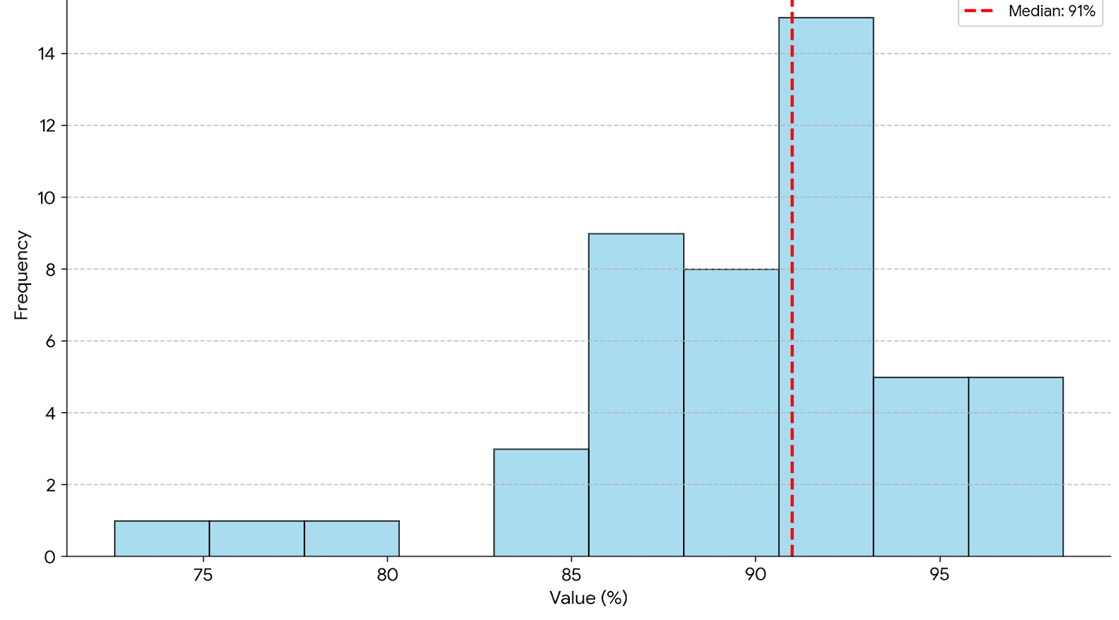
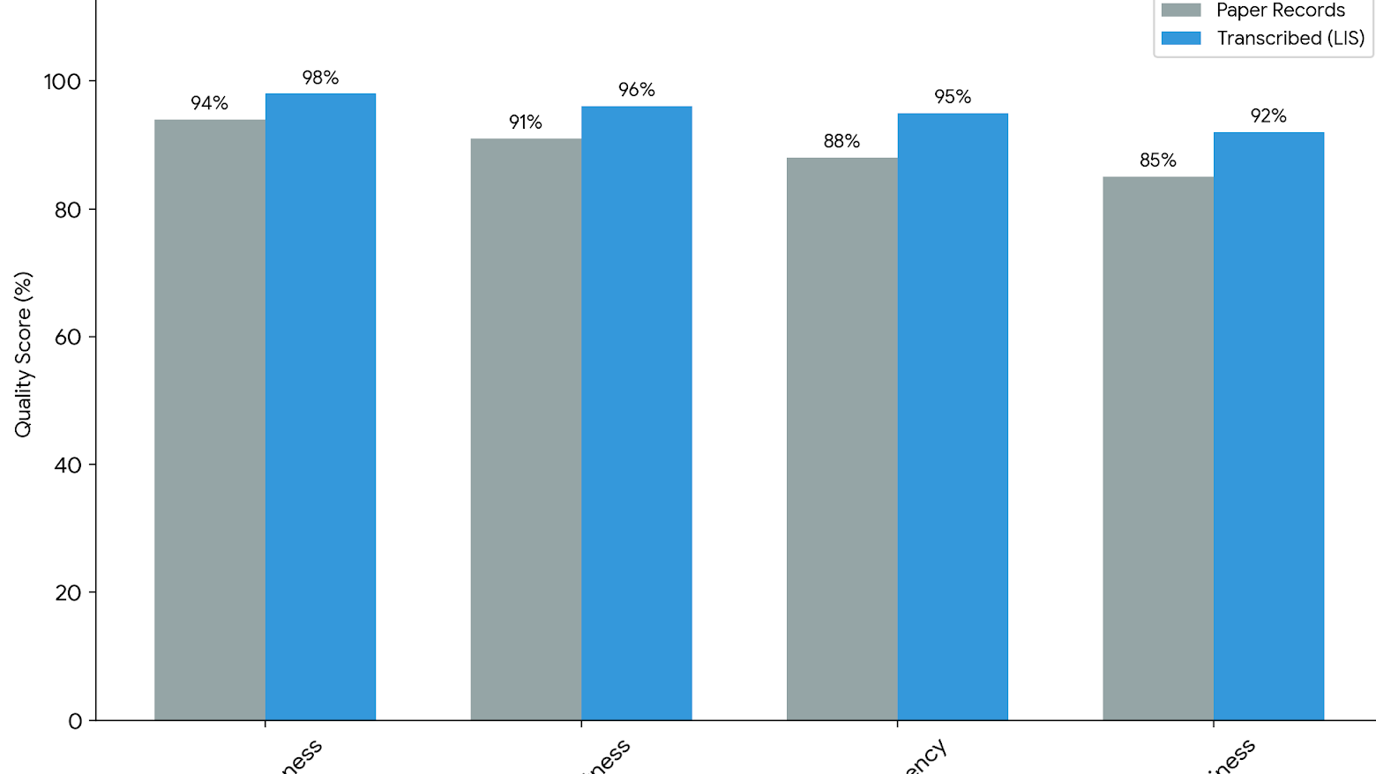
Results
  91% Completeness Median : percentage of required data elements per form vs captured in Remote Login and ADAM
  Age and Client ID were the most inconsistent fields (Client Registry not used) , missing in 87% of the incomplete records
  100% transcription accuracy for the subset of complete data entries/case forms
LLM OCR vs SQL data comparison – with 5 human seeded records , 7 model runs

Slide 8
Discussion
  The technical implementation of interoperability between the Outbreak Disease Data collection system(ADAM) and the LIS remained a significant bottleneck, requiring 8 to 11 weeks for successful pilot testing.
  The prerequisite training and development of Implementation Guides (available at fhir.nphl.go.ke) a one-year lead time. (Yet the technology isn’t new , i.e. REST API , JSON)
  Local LLMs for data quality checks

Slide 9
Conclusion
  Standardization significantly enhances data quality
  the timeline for deployment remains a barrier. To close the cost-benefit gap, the health sector must prioritize demand creation for high-fidelity data and develop simplified adoption pathways for system developers and vendors. Streamlining these implementation frameworks is essential for transitioning from reactive pandemic response to proactive national health defence.
  Technology MUST be able to scale
  Apply Ai in data quality Improvement

Slide 10
Policy Impact and Implications
  Standards for interoperability in Kenya are close to maturity
  Adopting international standards reduced the implementation time
  Implementation of the actual information systems remains a key factor and need for further study and improvement
  The Artificial Intelligence Bill, 2026 impact on Health System Use

Slide 11






Thank you!
Scan to visit our website
#KeHSCon2026
@NPHIKenya
www.nphi.go.ke

